Slide 1
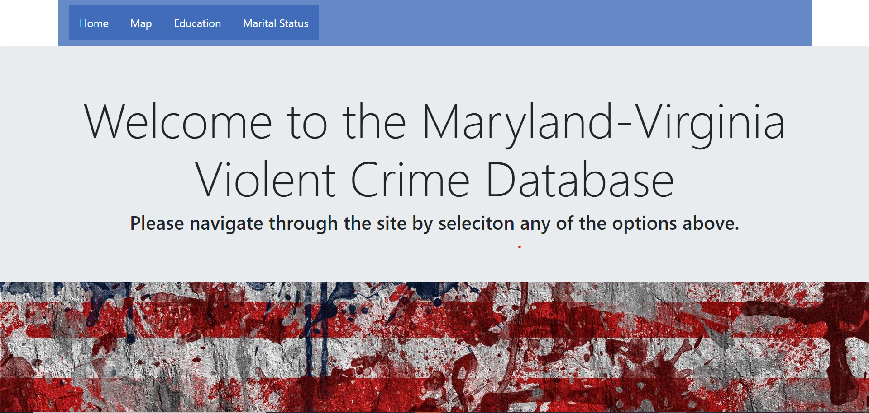
Maryland-Virginia Database Violent Crime
Temidayo Akinsanya
Oluwatobi Akinsanya

Slide 2
Background
Welcome to the Maryland-Virginia Violent Crime Database!
This database is made to display the violent crime data for cities in Maryland and Virginia. In addition, users can view education, marital status, and race in each city to help make life decisions and create awareness about crime and demographics in nearby cities.

Slide 3

Data Munging Techniques
Extraction
Census
Previous project code
Data Transformation
Reduced data to VA and MD
Data Loading
Create Heroku server
Send data to server via Postgres
Visualization
Link server to Postgres
HTML
JavaScript
Python Flask

Slide 4

Coding Approach
Data/Postgres
Heroku Server
HTML
CSS
Python Flask
Jupyter notebook
Leaflet
Marker Cluster
D3
JavaScript
Chartist
Mapbox
SVG
SQLAlchemy
Flask Library
Website

Slide 5

Visualization Demo

Slide 6

Any Questions?

